Slide 1
Fundamentals of Python
Chapter 1: Introduction

Slide 2
Objectives
After completing this chapter, you will be able to:
Give a brief history of Python
Compose and run a simple Python program
Fundamentals of Python: First Programs

Slide 3
Getting Started with Python Programming
Early 1990s: Guido van Rossum
  invented the Python programming language
Python is a high-level, general-purpose programming language for solving problems on modern computer systems
Useful resources at www.python.org
Fundamentals of Python: First Programs

Slide 4
Running Code in the Interactive Shell
Python is an interpreted language
Simple Python expressions and statements can be run in the shell
  Easiest way to open a Python shell is to launch the IDLE
  To quit, select the window’s close box or press Control+D
  Shell is useful for:
    Experimenting with short expressions or statements
    Consulting the documentation
Fundamentals of Python: First Programs

Slide 5
Why Python is a Unique Programming Language?
Python is one of the easiest programming language
Not a strict language.
Few lines of code can do a lot with python.
Great Community for help.
A lot of big companies use python like google, instagram, lyft, quora and more.
Fundamentals of Python: First Programs

Slide 6
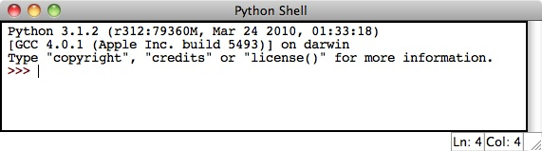

Running Code in the Interactive Shell (continued)
Fundamentals of Python: First Programs

Slide 7
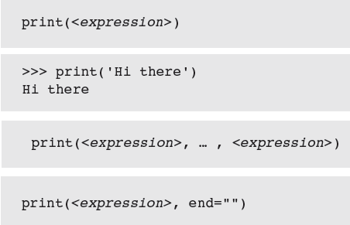
Input, Processing, and Output
Programs usually accept inputs from a source, process them, and output results to a destination
  In terminal-based interactive programs, these are the keyboard and terminal display
Fundamentals of Python: First Programs

Slide 8
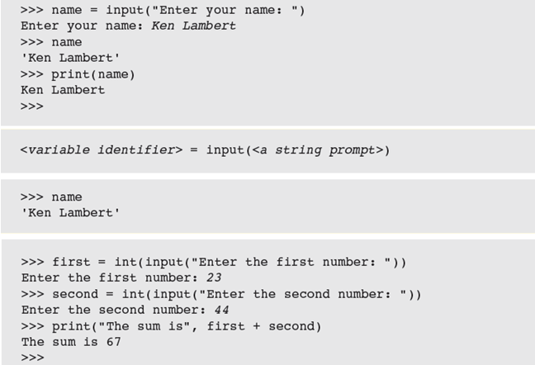
Input, Processing, and Output (cont’d)
Fundamentals of Python: First Programs

Slide 9
Editing, Saving, and Running a Script
Select New Window from the File Menu
Type your Python Source Code.
Use the File Menu, then Save using the .py extension
We can then run Python program files or scripts within IDLE
  Run Menu, then Run Module or press F5 (Windows)
Running a script from IDLE allows you to construct some complex programs, test them, and save them in program libraries to reuse or share with others
Fundamentals of Python: First Programs

Slide 10
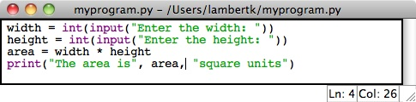

Editing, Saving, and Running a Script (continued)
Fundamentals of Python: First Programs

Slide 11
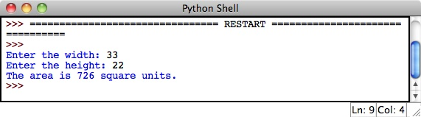
Editing, Saving, and Running a Script (continued)
myprogram.py
Fundamentals of Python: First Programs

Slide 12
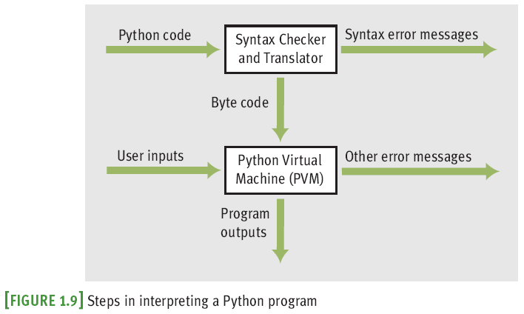
Behind the Scenes:
How Python Works
Fundamentals of Python: First Programs

Slide 13
Detecting and Correcting Syntax Errors
Programmers inevitably make typographical errors when editing programs, called syntax errors
  The Python interpreter will usually detect these
Syntax: rules for forming sentences in a language
When Python encounters a syntax error in a program, it halts execution with an error message
Fundamentals of Python: First Programs

Slide 14
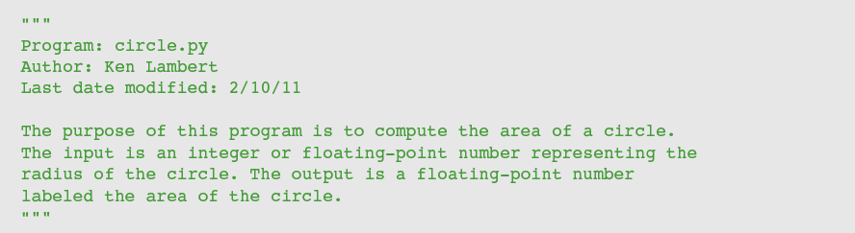
Program Comments and Docstrings
Docstring example:
End-of-line comment example:
Fundamentals of Python: First Programs

Slide 15
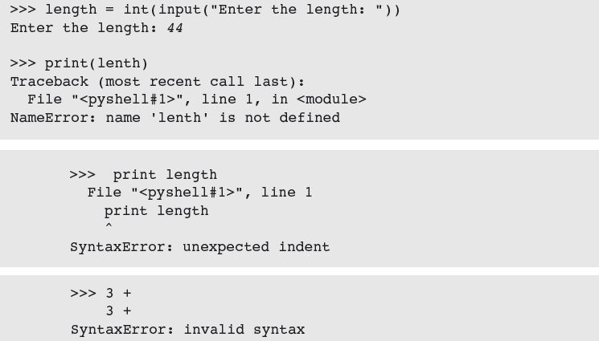
Detecting and Correcting Syntax Errors (continued)
Fundamentals of Python: First Programs

Slide 16
Summary (continued)
Languages such as Python are high-level
Interpreter translates a Python program to a lower-level form that can be executed on a real computer
Python shell provides a command prompt for evaluating and viewing the results of Python expressions and statements
Fundamentals of Python: First Programs

Slide 17
Summary (continued)
IDLE is an integrated development environment that allows the programmer to save programs in files and load them into a shell for testing
Python scripts are programs that are saved in files and run from a terminal command prompt
When a Python program is executed, it is translated into byte code
  Sent to PVM for further interpretation and execution
Syntax: set of rules for forming correct expressions and statements in a programming language
Fundamentals of Python: First Programs

Slide 18
Thank you!
Any Questions?
Fundamentals of Python: First Programs

